Slide 1
Introduction to IPv6 (History and Address Representation)

Slide 2
History of IPv6
» 1992 – an impending shortage of IPv4 address space was first recognized.
» 1994 – IETF launches work into IPv6
» 1998 – First RFC (2460) for IPv6 written
» 2006 – RFC 4291 stabilized (address structure)
» 2008 – U.S. Federal Government mandates IPv6-compatibility of all backbone devices of Federal Agencies
» 2015 – ARIN runs out of IPv4 addresses.

Slide 3
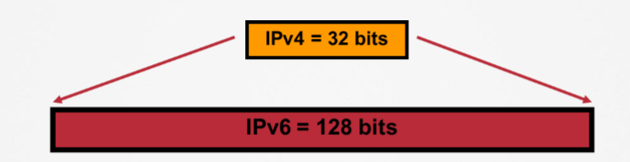
Introduction to IPv6
» 128-bit addressing system
» Expressed in hexadecimal instead of decimal
» Colon “:” used to separate group of four-hex characters (a “word”)
» 4 bits = 1 hex character
» Example: 2001:0000:0000:0000:0000:0001:1230:000A

Slide 4
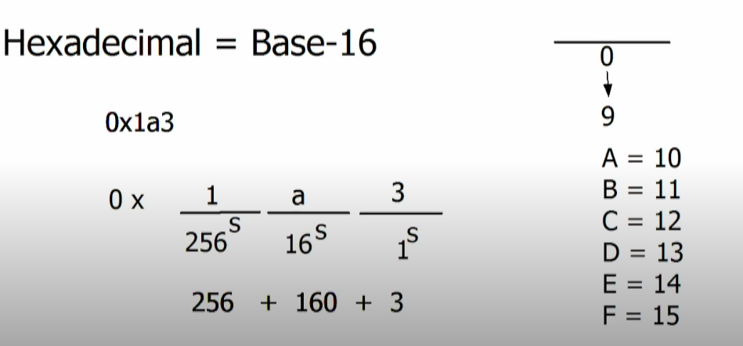
Introduction to IPv6

Slide 5
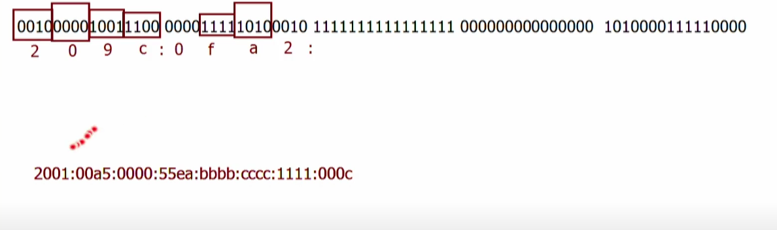
Introduction to IPv6

Slide 6
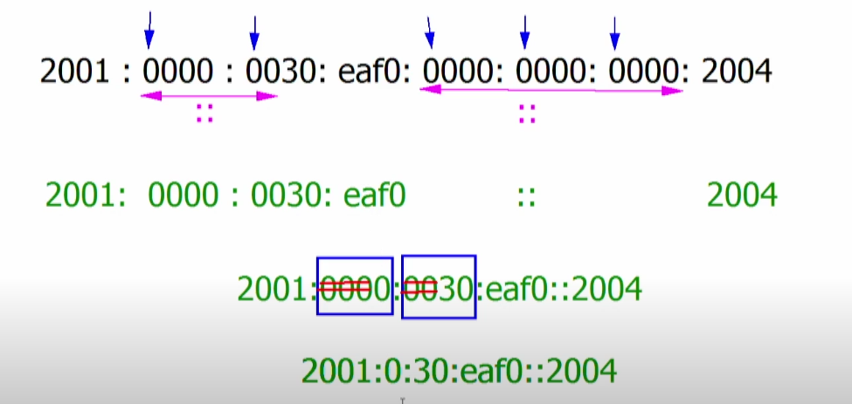
Ipv6

Slide 7
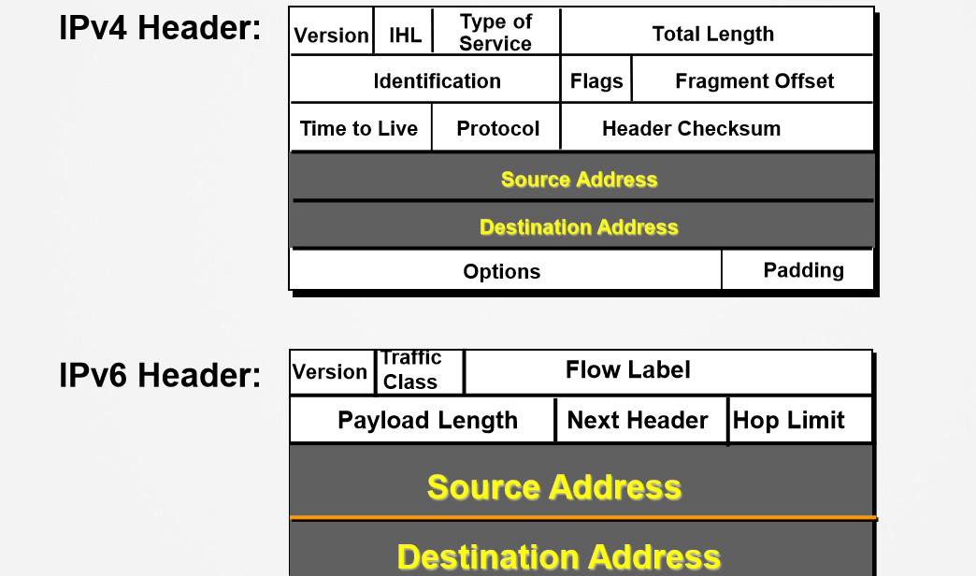
IPv4 and IPv6 Header Comparison

Slide 8
Introduction to IPv6 (Interface-IDs)
» IPv4 host address
• Network/subnet portion (prefix)
• Host portion (host bits)
» IPv6 host addresses
• Network/subnet portion (prefix)
• Interface Identifier
• Can also be dynamically-derived (EUI-64)

Slide 9
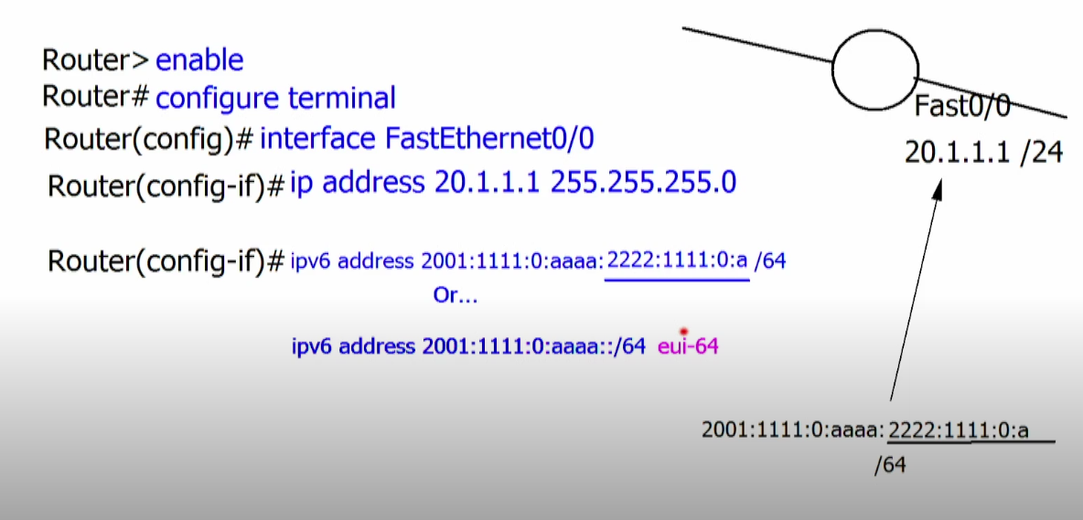
Introduction to IPv6 (Interface-IDs)

Slide 10
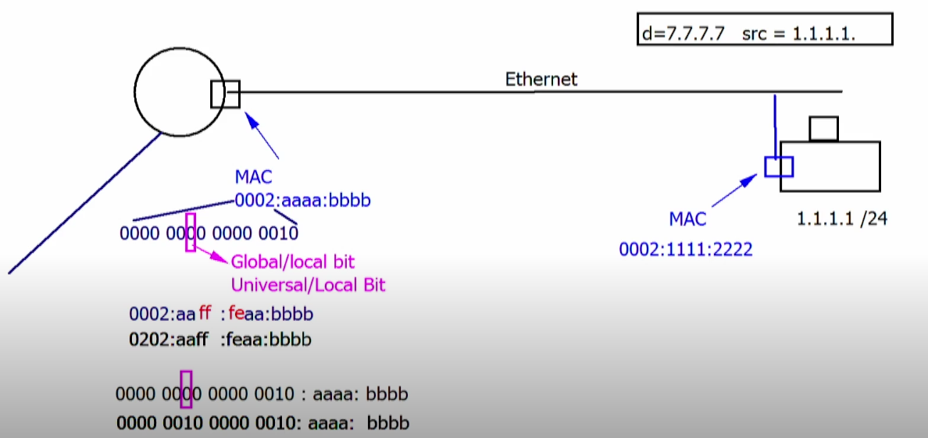
Introduction to IPv6 (Interface-IDs)

Slide 11
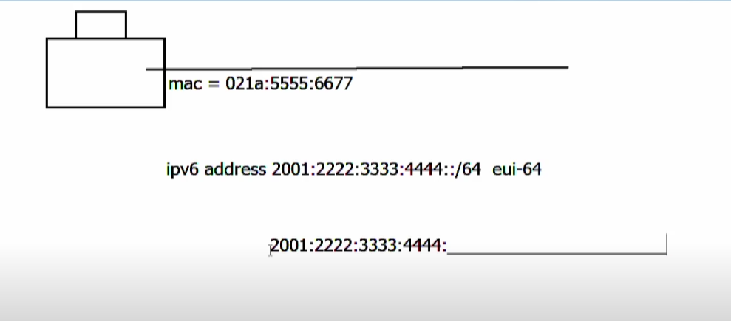
Introduction to IPv6 (Interface-IDs)

Slide 12
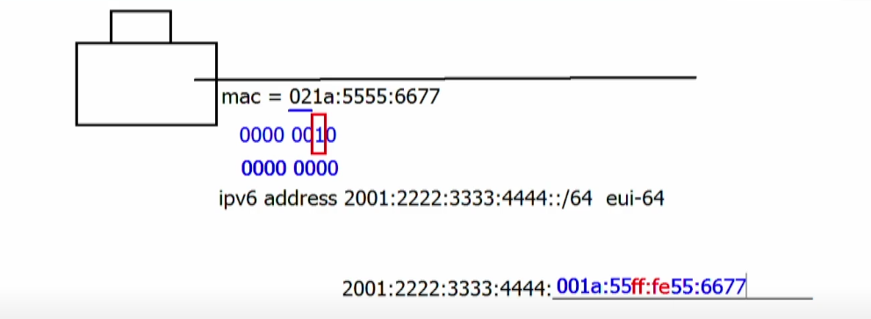
Introduction to IPv6 (Interface-IDs)

Slide 13
Types of IPv6 Addresses
» Link-local addresses
• Assigned automatically as an IPv6 host comes online
• Similar to the 169.254.x.x address of IPv4
• Always begin with “FE80::/10”
• Last 64 bits is the 48-bit MAC address with “FFFE” inserted in the middle
» Global Unicast Addresses
• Have their high-level 3 bits set to 001; ex: 2000::/3
• Global routing prefix is 48 bit or less

Slide 14
Types of IPv6 Addresses
» Unique Local Addresses
• Not globally routable
• Similar to the private addresses of IPv4
• Always begin with “FC00::/7”
» Multicast Address
• FF00::/8
• As long as the first 8-bits take the form of 1111 1111, that’s a multicast address.
• IPv6 nodes listen to several IPv6 Multicast Groups by default.

Slide 15
Types of IPv6 Addresses
» Anycast
• Two-or-more nodes using the same IPv6 address
• Used for load-balancing
• Indistinguishable from Unicast address

Slide 16
Introduction to IPv6 (IPv6 Neighbor Discovery)
ICMPv6 and NDP
» NDP = Neighbor Discovery Protocol
» Makes use of new ICMPv6 message types
• Neighbor Solicitation
• Neighbor Advertisement
• Router Solicitation
• Router Advertisement

Slide 17
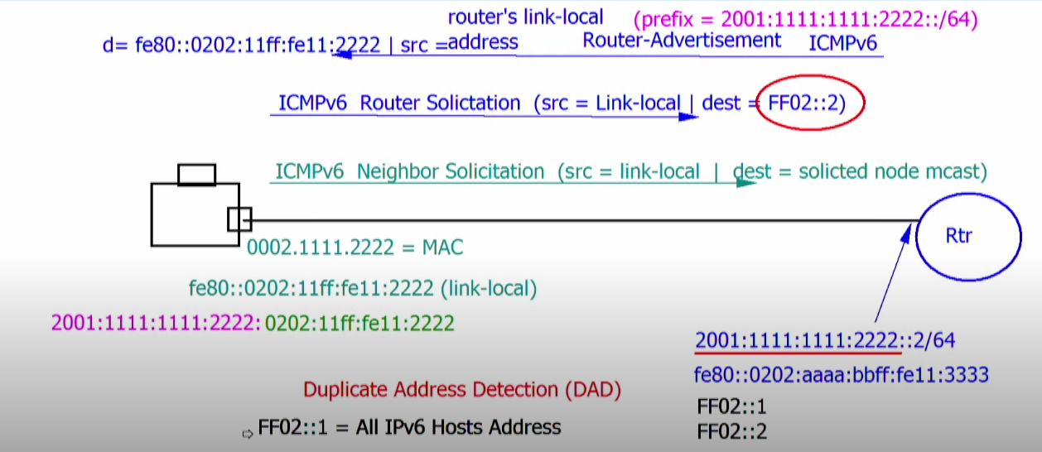
IPv6 Neighbor Discovery

Slide 18
Types of IPv6 Addresses
» Solicited Node Multicast Address
• FF02:0:0:0:0:1:FF/104
• Last 24-bits taken from interface-ID (next slide)
• Automatically provisioned like Link-Local addresses
• Used for L3-to-L2 address resolution

Slide 19
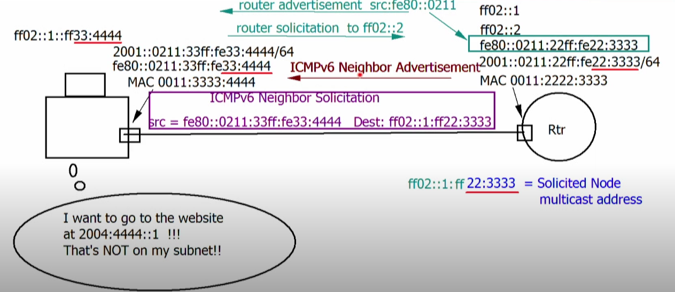
L2 resolution in IPv6

